Slide 1
Automatic Scoring Feature
Guide: Prof. Raghunathan Rengaswamy
Shashank M Patil (CH18B022)

Slide 2

Acknowledgements
GITAA Team
Suchitra Veeravalli Ma’am
Navin Kumar Sir
Baby Aarthy Ganesh Kumar Ma’am
Selvamani R Sir
Anilkumar Vempadapu Sir
Sangeetha Jayasankar Ma’am
Bhuvaneswari Ramesh Ma’am
Prof. Arun K Tangirala

Slide 3
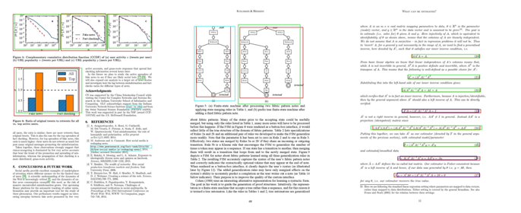
Problem Statement
Why automatic scoring?
Efficiency
Objectivity
Scalability
Immediate Feedback
Customized Learning
Sample Output from FFD Algorithm (taken from paper)
Note: Evaluation of the score based on figures, formulas and tables

Slide 4
Method Overview
UX: Prof uploads zip file with students’ assignments (integrated with Moodle) with template answer key → Scores generated for each student
3 Step Process
Detect: FFT (figure, formula, table) in the answer key and student assignment.
Analyse: Compare each figure from answer key with all the figures detected in assignment
Evaluate: Once the we have the similarity scores, give relevant weightages to the figures in answer key to arrive at the final mark

Slide 5
Detection

Slide 6
Literature Survey
Methods
based on heuristics, which includes colour-based features, shape-based features, and/or geometric features, etc.
deep learning approaches include conventional neural networks, region proposal networks and/or deformable neural networks
Papers (deep learning approaches, best results so far)
Vo et al – based on deep neural networks which is an ensemble of fast-RCNN, and faster-RCNN
Li et al - combination of conventional computer vision techniques, deep neural networks, and statistical models.

Slide 7
Literature Survey
Datasets
ICDAR 2017 POD
2000 English document page images with annotations for figure, table and formulae
Labeling - includes missing labels, wrong labels, non-uniform labeling conventions
Annotations - at one instance, figures were annotated considering outer boundary, whereas on other pages outer boundary was totally neglected
FFD Dataset
680 document images with annotations for only formulae and figure in the standard format
Manually annotated by a single person

Slide 8
Custom Dataset
Building the feature for tackling hand written answer sheets as well.
ICDAR Dataset : ~2500 images (tables, formula, figure)
FFD Dataset: ~700 images (formula, figure)
Handwritten answer sheets: ~3000 images (formula, figure, table)
Model
Tuned the YOLOv8 model on the dataset for object detection
Open source, state of the art model in terms of accuracy and precision

Slide 9
Yolov8
Loss functions included the model:
Localization loss - predict the bounding box coordinates accurately, priority in our case (mse)
Confidence loss - differentiate between the object and background binary cross entropy
Classification loss - predicting the classes, cross entropy

Slide 10
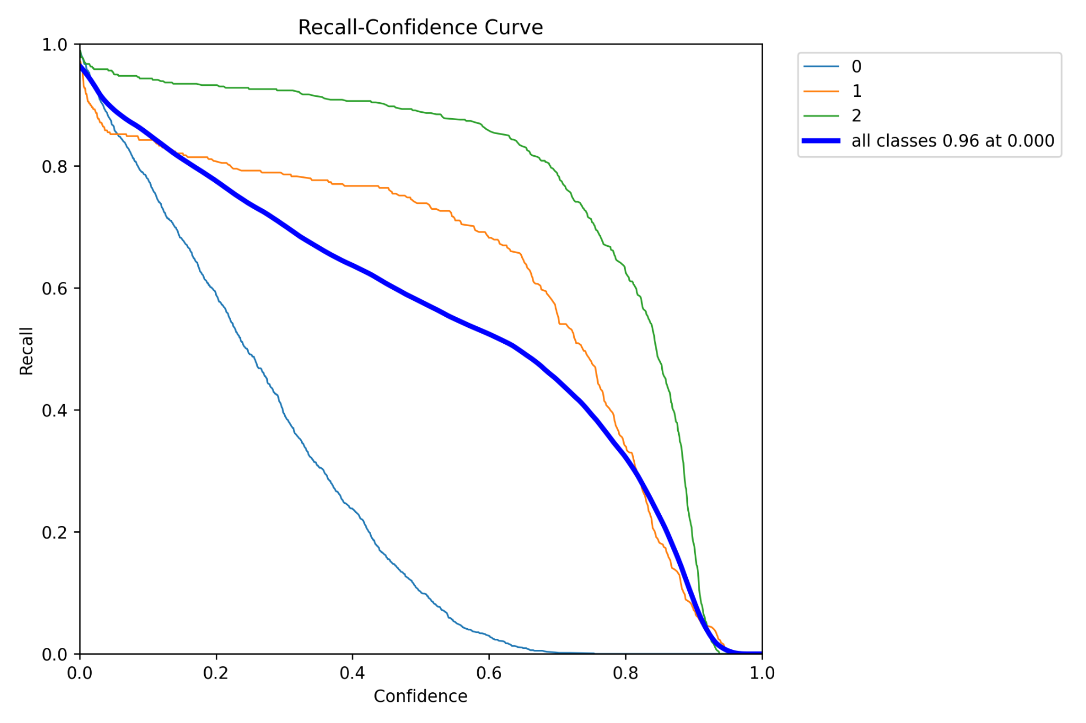
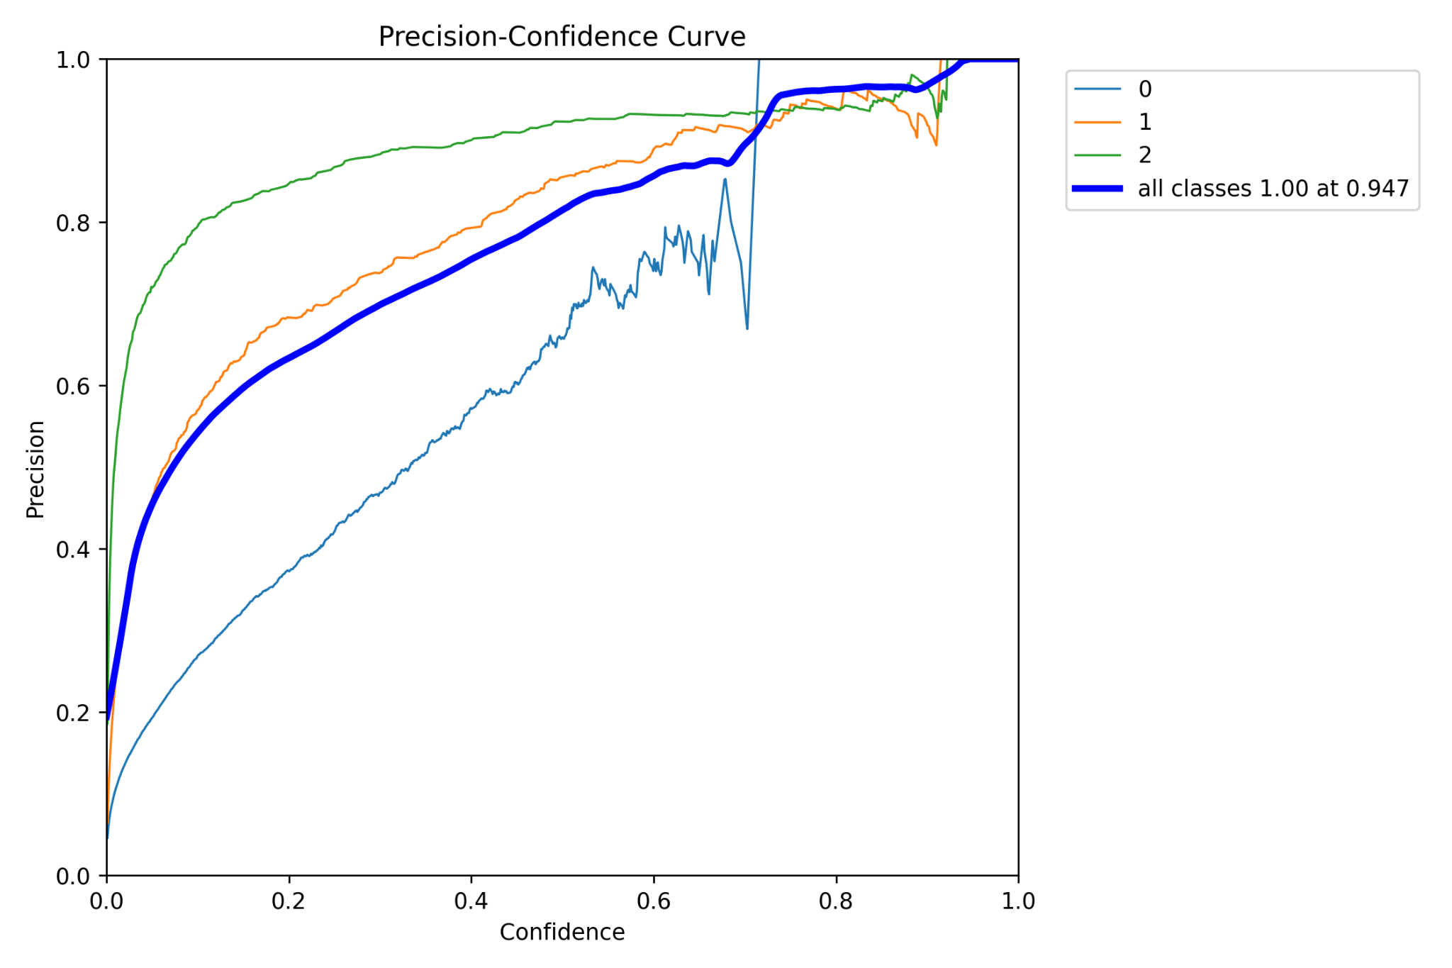
Results

Slide 11
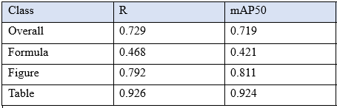
Results
Based on 729 instances (10% of the data)

Slide 12
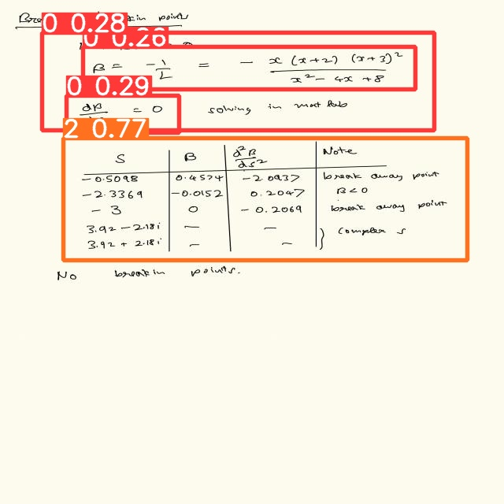
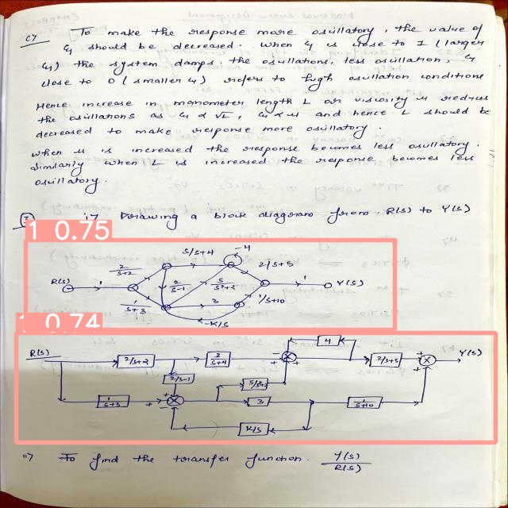
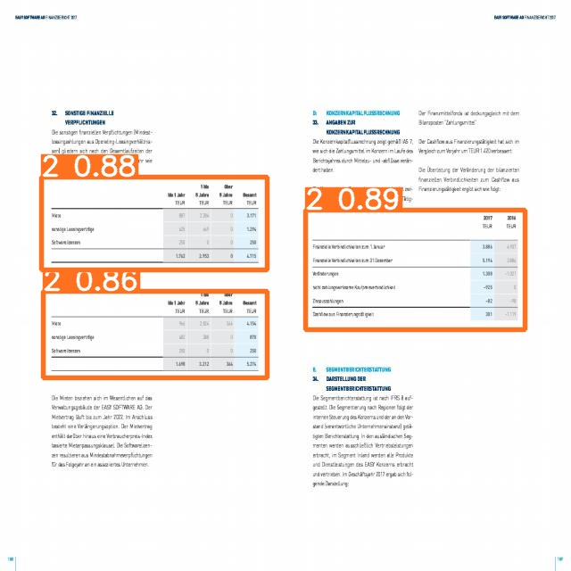
Results (Egs)

Slide 13
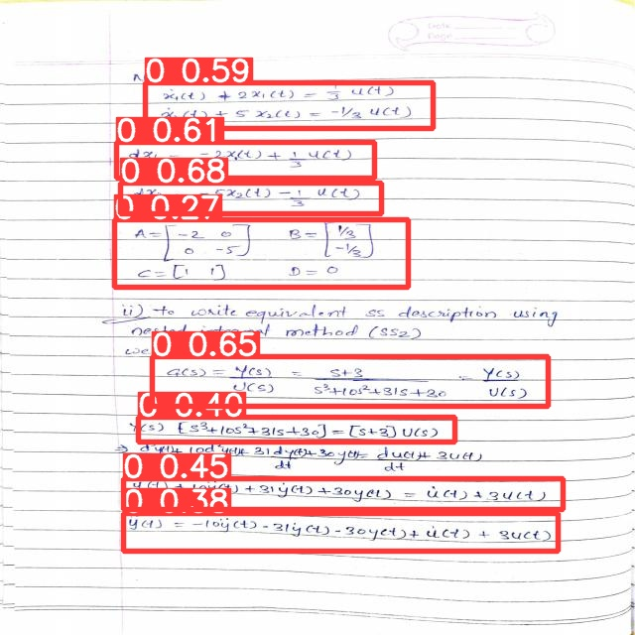
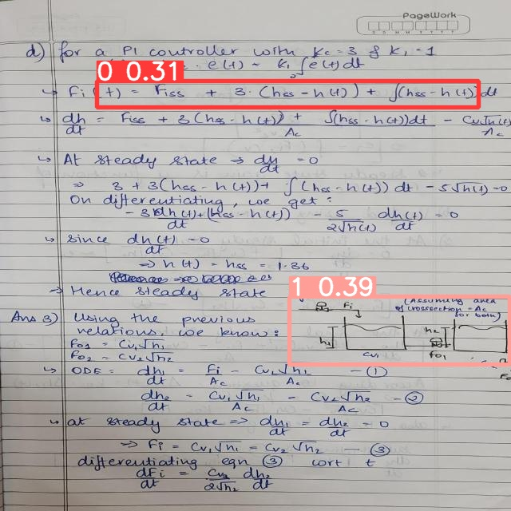
Results

Slide 14
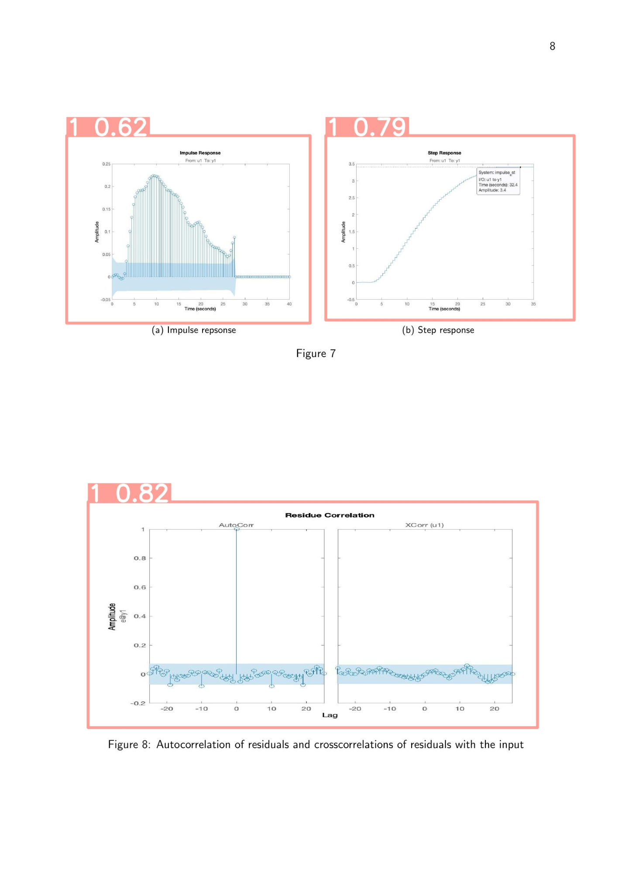
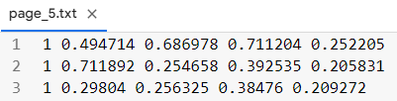
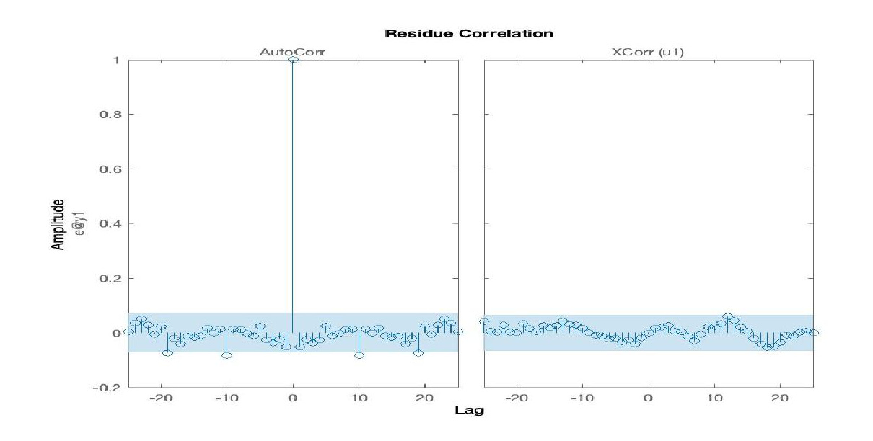
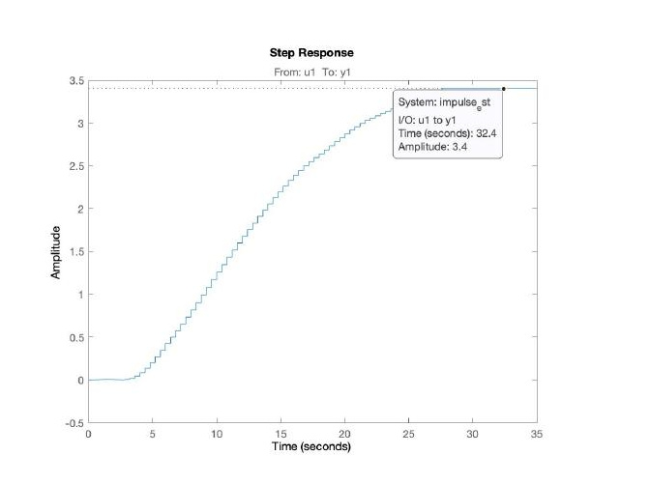
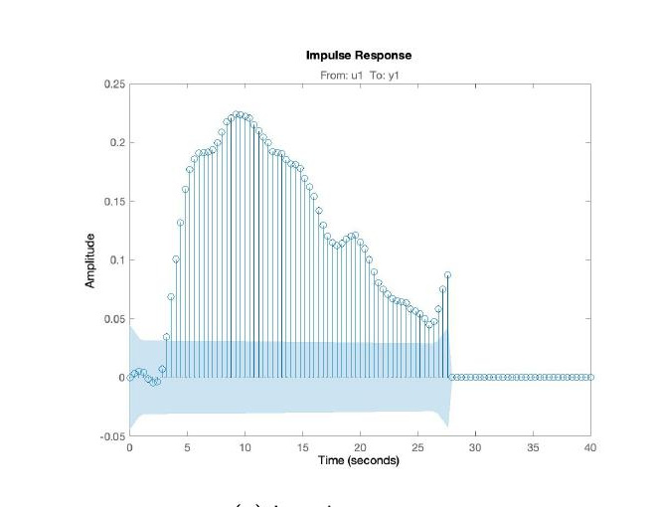
What do we have now?

Slide 15
Analyse

Slide 16
Literature Survey
Traditional methods - histogram comparison, cosine similarity, euclidean distance
However they don’t capture the complex relationships between the images
Methods in use
Siamese networks
Vision Transformer
Deep Image Retrieval Models
Keeping the following factors in mind - Data availability, Dataset size and Image characteristics, chose Vision Transformer model

Slide 17
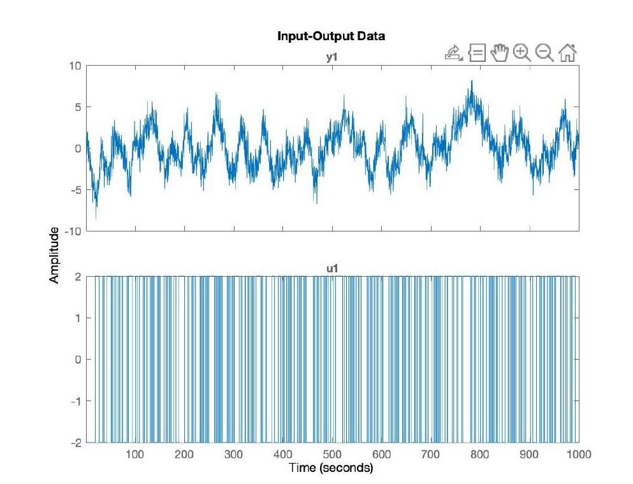
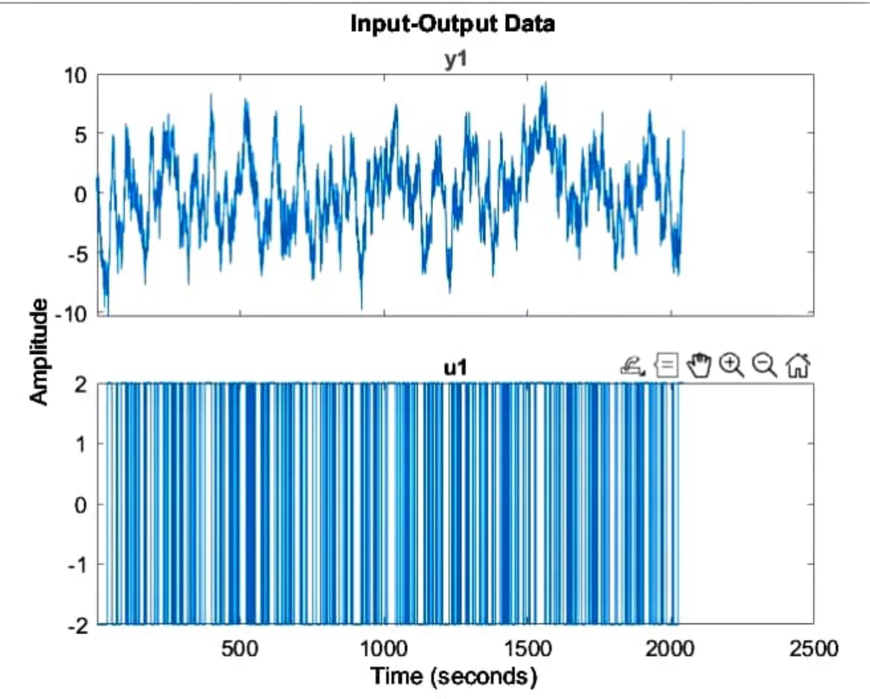
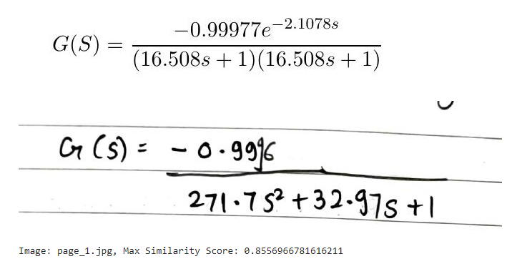
Results

Slide 18
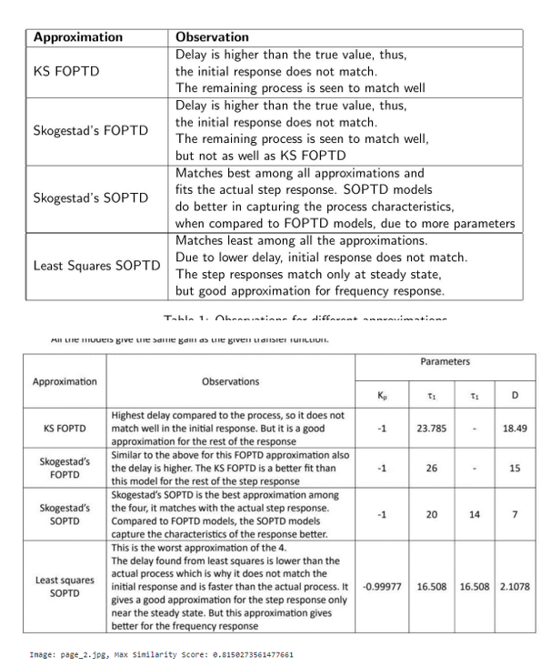
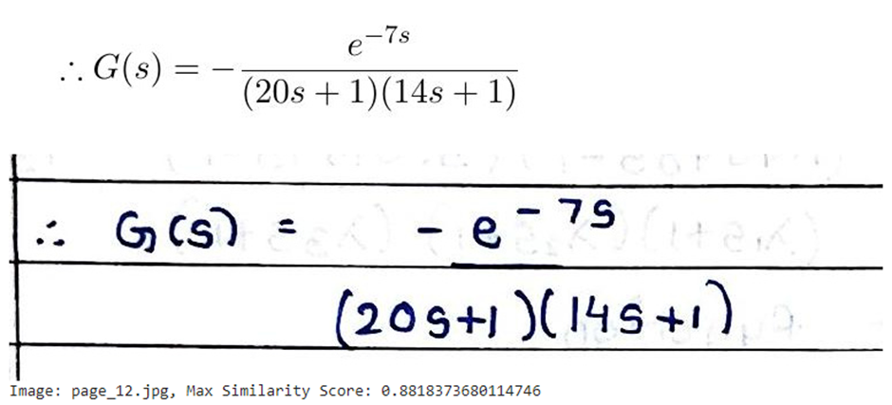
Results

Slide 19
What do we have now?
Similarity scores of the template answer sheet extracted images against all the extracted images of the students answer sheet
We consider the image corresponding to the max score as the best match for the given template answer sheet image

Slide 20
Evaluate

Slide 21
Method followed for evaluation
We need to arrive at a final score
Usually, marks are allotted for each step a student has written correctly
Analogously, in this case, professor will manually input the marks for each image (figures/formulas/tables) in the template answer sheet
We multiply the step marks with the similarity score to arrive at the score for that step
Summing up for all the images in template answer sheet, we get the final score of the student

Slide 22
Future Scope
Dataset for object detection can be made robust and trained before deployment
Different models/ensemble methods can be used for similarity score calculations. Labelled data can be prepared for this purpose.
Need for quantifying how well the algorithm is performing in evaluating the score
Converting the handwritten formula to latex format before calculating the similarity
Can be used at places where there is a designated place to answer a question unlike handwritten assignments.

Slide 23
References
Papers
X. Li, F. Yin, and C. Liu. Page object detection from pdf document images by deep structured prediction and supervised clustering. [Link]
N. Vo, K. Nguyen, T. Nguyen, and K Nguyen. Ensemble of deep object detectors for page object detection. [Link]
Younas, Junaid & Rizvi, Syed Tahseen Raza & Malik, Muhammad Imran & Shafait, Faisal & Lukowicz, Paul & Ahmed, Sheraz. (2019). FFD: Figure and Formula Detection from Document Images. [Link]
Datasets
ICDAR 2017 POD [Link]
FFD Dataset [Link]

Slide 24
Thank You

Slide 25
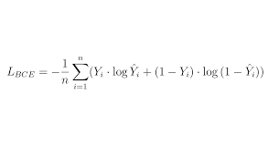
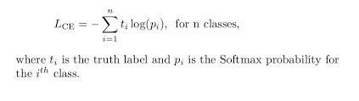
Appendix - Yolov8
Loss functions
Bbox - how tight is the bounding box
Cls - classification (cross entropy)
Lce = - sum(i,n) t_i * log(p_i) for n classes
p_i softmax probability

Slide 26
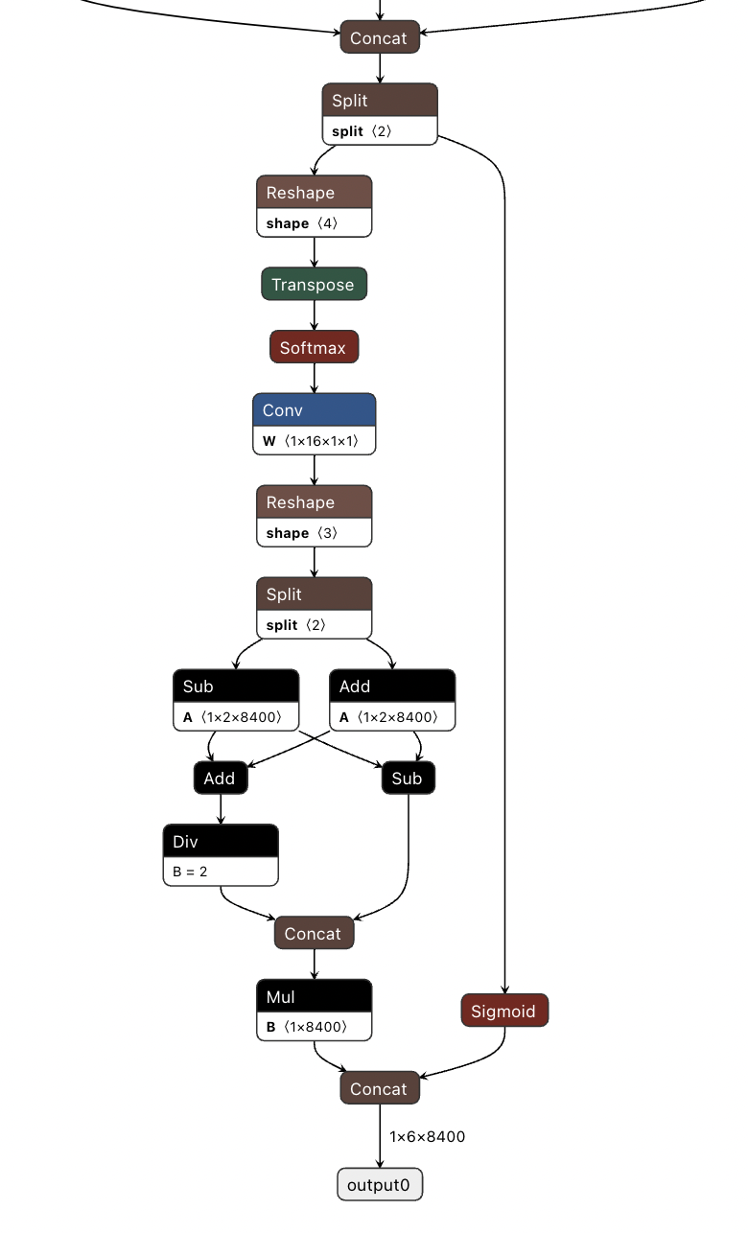
Appendix - Yolov8
Model Architecture

Slide 27
Appendix - VIT B 32
Visual Transformer
The Vision Transformer (ViT) is a model that applies the transformer architecture, originally developed for natural language processing, to computer vision tasks such as image classification.
The "B/32" notation in ViT-B/32 represents the specific configuration of the ViT model. It consists of the following details:
"B" indicates the model size or scale. In the case of ViT, larger model sizes generally indicate higher capacity and potential for improved performance. The specific naming conventions for model sizes may vary across different implementations or papers.
"32" refers to the patch size used in the model. In ViT, the input image is divided into smaller patches, and each patch is treated as a token for processing within the transformer. The patch size defines the dimensions of these patches, with "32" indicating that each patch is a 32x32 pixel square.
The ViT-B/32 model, like other ViT variants, learns representations for images by leveraging the self-attention mechanism of the transformer architecture. This allows the model to capture global relationships between different patches, enabling it to understand the context of the entire image.

Slide 28
VIT B 32
The self-attention mechanism is a key component of the transformer architecture, originally introduced for natural language processing (NLP) tasks, and later adapted for computer vision tasks such as image classification in models like the Vision Transformer (ViT).
In a transformer, self-attention allows the model to weigh the importance of different elements (words in NLP or image patches in computer vision) within a sequence in order to capture dependencies and relationships between them. It enables the model to attend to different parts of the input sequence while processing each element.
The self-attention mechanism computes the attention scores between all pairs of elements in the input sequence. These scores indicate the importance or relevance of one element with respect to the others. The attention scores are used to calculate weighted sums of the values associated with each element, creating context-aware representations.
Here's a high-level overview of the self-attention mechanism:
1. Inputs:
- Query: Represents the element for which attention is being computed.
- Key: Represents the elements against which the query is compared.
- Value: Represents the information associated with each element.
2. Calculating Attention Scores:
- For each query element, the similarity between the query and all key elements is computed using dot product or other similarity measures.
- The similarity scores are scaled using a softmax function to obtain attention weights that sum to 1.
3. Weighted Sum:
- Each value element is multiplied by its corresponding attention weight.
- The resulting weighted values are summed together to create the context-aware representation for the query element.
4. Multi-Head Attention:
- In practice, the self-attention mechanism is often performed multiple times in parallel, with different learned linear projections called attention heads.
- This allows the model to capture different patterns or relationships at different levels of granularity.
The self-attention mechanism enables the transformer to capture long-range dependencies, as each element can attend to any other element in the sequence. It has been shown to be effective in modeling both spatial and temporal relationships, making it well-suited for tasks that require capturing context and relationships between elements.
In computer vision, self-attention has been applied to image classification tasks, where the input sequence consists of image patches or flattened features. By allowing the model to attend to different patches while processing each patch, self-attention helps capture global relationships and long-range dependencies in the image.

